Slide 1
IS590DT: Data Mining Applications WEEK 3: Evaluation
Spring 2019
Yingjun Guan
yingjun2@illinois.edu
http://ischool.illinois.edu/people/yingjun-guan

Slide 2
Previously on……
Assignments …
Late submission
Readings …
Weekly reading;
DMRG
Projects …
Two fists (Dataset + RQ)
Template
Instruction vs project

Slide 3
Previously on……
What have you learnt so far?

Slide 4
Basic concepts
What’s data mining?
Data mining?
Mining data?
Mining from data?
Mining {what} from data?
Mining information from data?
DIKW model.

Slide 5
DM? ML?
Data mining vs machine learning (scopes)

Slide 6
DM? ML?
Data mining vs machine learning (phases)

Slide 7
Supervised v.s. unsupervised learning
What do they share in common?
What’s the difference?
Apart from them, have you heard about…
Semi-supervised learning
Reinforced learning
Active learning

Slide 8
Classification vs clustering
May I get some examples for both?
What’s the difference?
Which is better / which do you prefer?

Slide 10
How to evaluate a classification?
What is classification?
How to evaluate the classification. What is good?
Confusion matrix!
Eg: Let’s first see a simple confusion matrix.

Slide 11
Let’s see a simple confusion matrix.
TP
FP
TN
FN

Slide 12
Confusion matrix
Let’s put it more general…
Type 1 error
Type 2 error

Slide 13
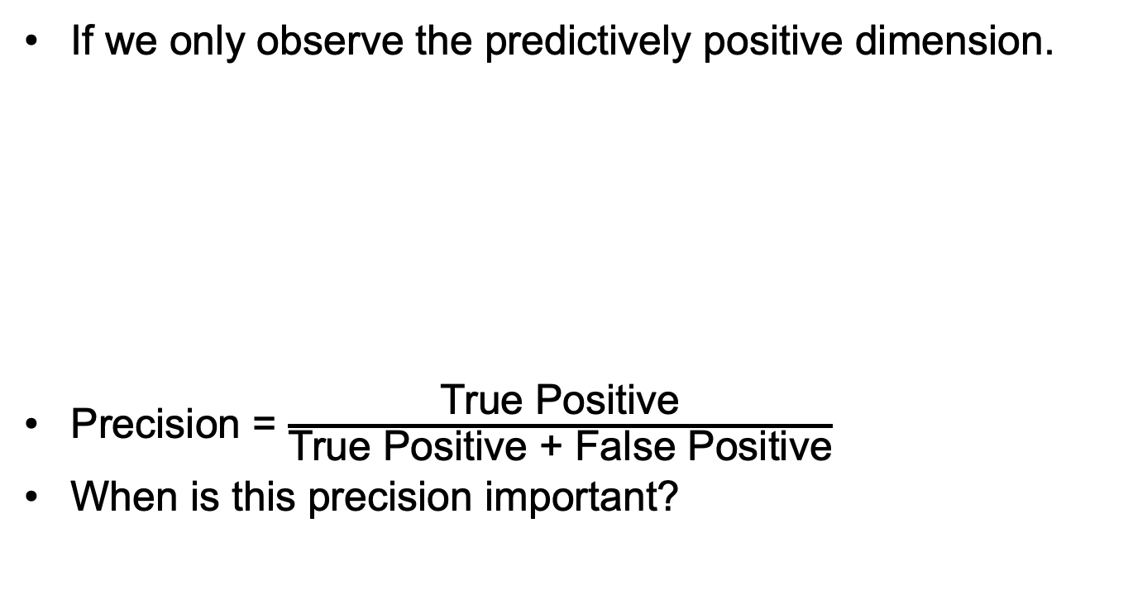
Confusion matrix & precision
If we only observe the predictively positive dimension.
Precision = $\frac{\text{True} \text{Positive}}{\text{True} \text{Positive} \text{+} \text{False} \text{Positive}}$
When is this precision important?
When it predicts positive, how often is it correct?

Slide 14
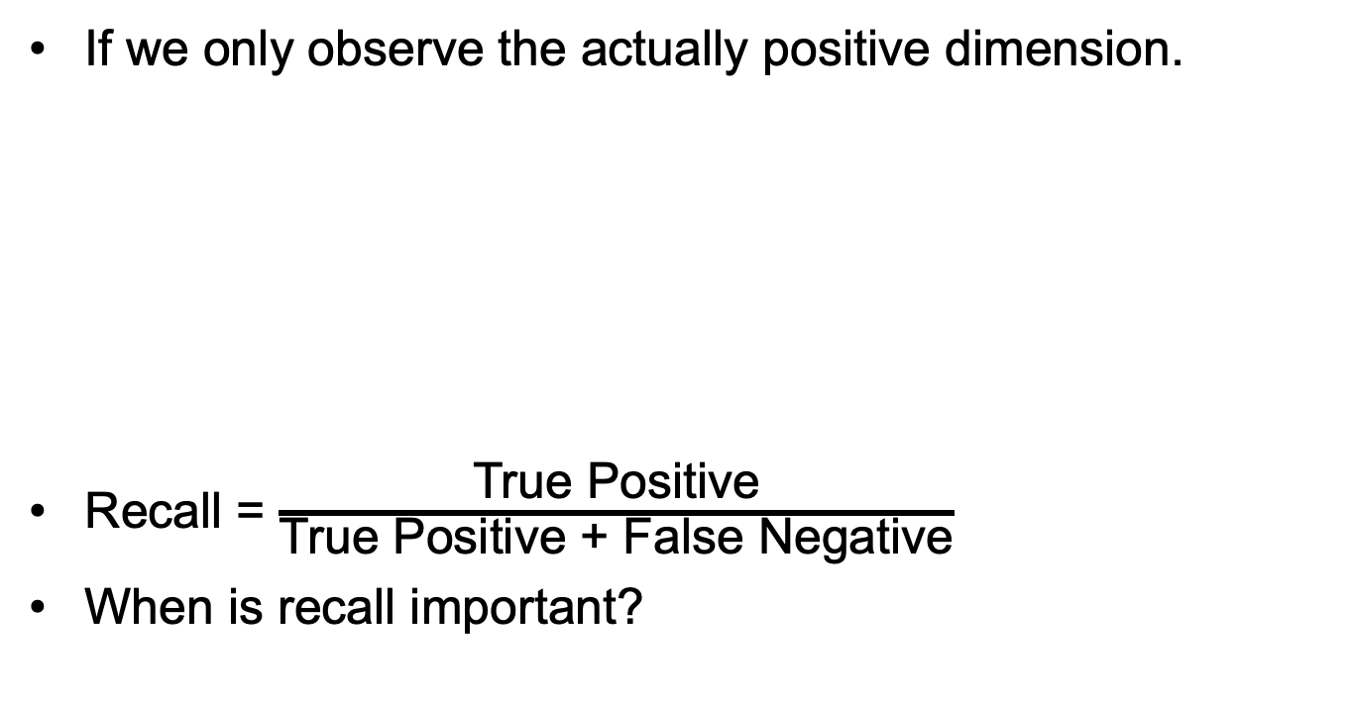
Confusion matrix & Recall
If we only observe the actually positive dimension.
Recall = $\frac{\text{True} \text{Positive}}{\text{True} \text{Positive} \text{+} \text{False} \text{Negative}}$
When is recall important?
Recall helps when the cost of false negatives is high.

Slide 15
Precision vs Recall
How does precision reach maximum? how much?
How does recall reach maximum? How much?
There’s a trade-off between precision and recall.
When precision increases, recall drops.
When recall increases, precision drops.

Slide 16
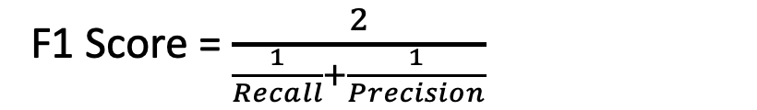
Other measures…
F1 score.
F1 is a helpful overall measure of a model’s accuracy that combines precision and recall.
- <Harmonic mean>
F1 Score = $\frac{2}{\frac{1}{Recall}+\frac{1}{Precision}}$
Balance between the precision and the recall.
Notes:
how often is our model correct

Slide 17
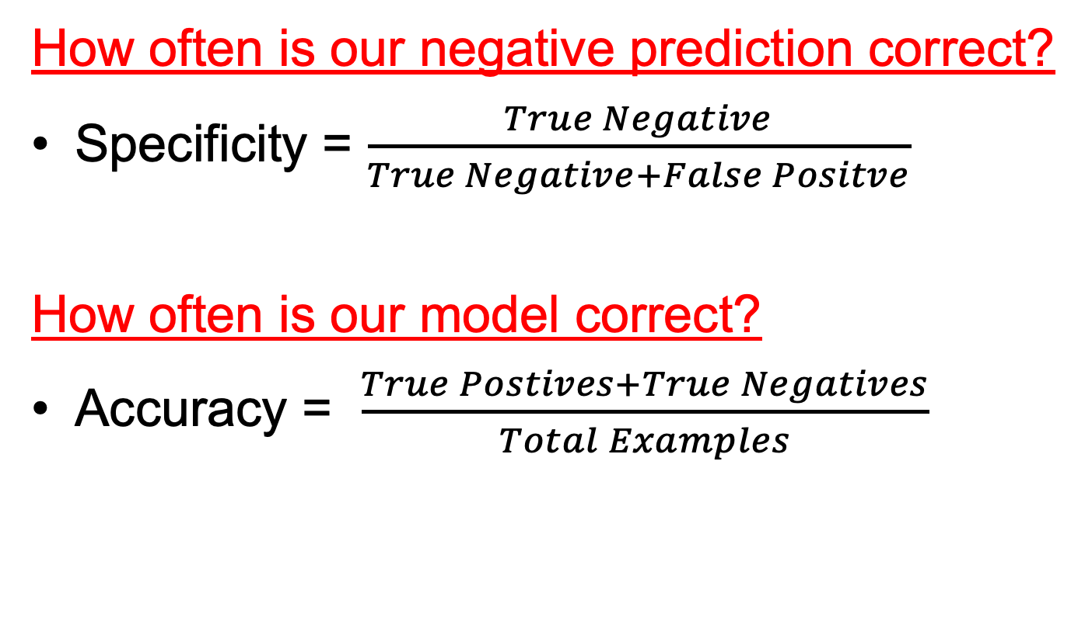
Other measures…
How often is our negative prediction correct?
Specificity = $\frac{True Negative}{True Negative+False Positve}$
How often is our model correct?
Accuracy = $\frac{True Postives+True Negatives}{Total Examples}$
Notes:
how often is our model correct

Slide 18
A quick summary

Slide 19
dimensionality
What if the class is not binary, but multi-dimensional?
Can you read the following graph?
On your paper, try writing down the equation to calculate the following: precision, recall, F1, accuracy for A

Slide 20
Take some time calculating these!
Rabbit precision = ?,
Rabbit recall = ?
Rabbit F-1 score = ?
Rabbit accuracy = ?
Wrong expression! Should be model accuracy!
Truth
Prediction

Slide 22
Weka time!
Let’s try confusion matrix!
Data : weka – weather.nominal.arff
Method:
Weka – functions - logistic
Weka – functions – SMO (SVM)
Target:
Retrieve the confusion matrix.
Make sure to understand them and can calculate.

Slide 23
AUC - ROC
To evaluate classification models, we can also count on an AUC - ROC Curve.
ROC (Receiver Operating Characteristics)
AUC (Area Under The Curve) ; AOC
Also written as …
AUROC (Area Under the Receiver Operating Characteristics)

Slide 24
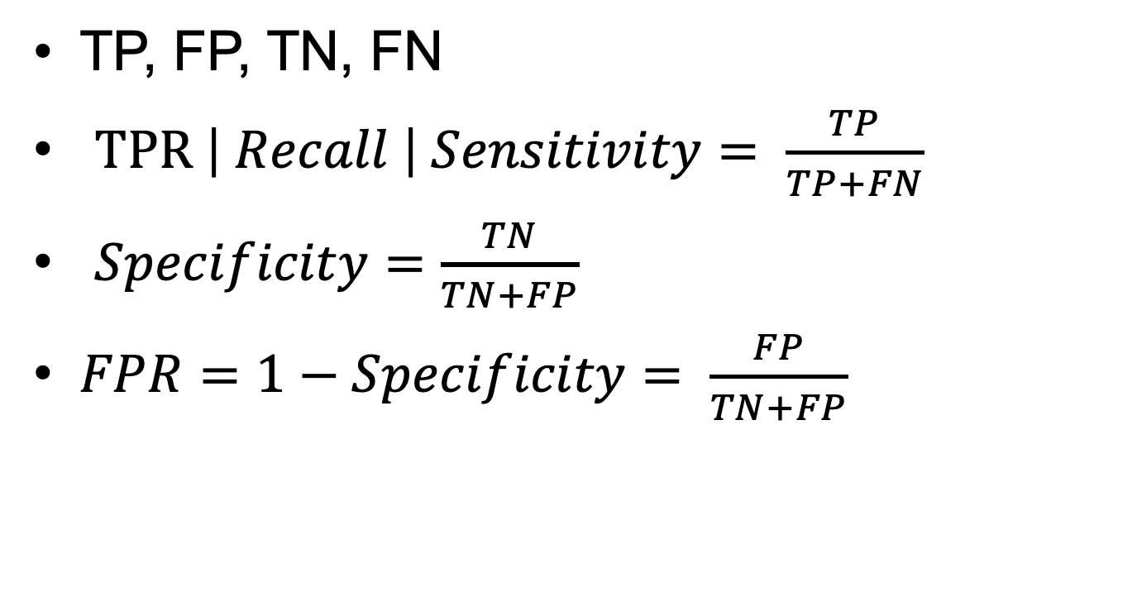
Review and new concepts…
TP, FP, TN, FN
$TPR \left| Recall \right| Sensitivity= \frac{TP}{TP+FN}$
$Specificity=\frac{TN}{TN+FP}$
$FPR=1−Specificity= \frac{FP}{TN+FP}$

Slide 25
ROC
It is a performance graphing method.
TPR vs FPR
Used for evaluating data mining schemes, and comparing classifiers.
AUC range (0,1)

Slide 26
Steps…
Scoring and ranking
Scoring is related to classification.
We are interested in a single class (positive class).
Instead of assigning each test instance a definite class, scoring assigns a probability estimate (PE) to indicate the likelihood that the example belongs to the positive class.

Slide 27
Scoring and Ranking
After each example is given a PE score, we can rank all examples according to their Pes (in the descending order).
We then divide the data into n (say 10) bins. A lift curve can be drawn according how many positive examples are in each bin. This is called lift analysis.

Slide 28
Binning & thresholding
We could predefine the parameters of binning and thresholding.
Assume that our dataset has 10,000 instances.
Binning: Divide the ranked dataset into 10 bins.
Each bin has 1000 test instances.
Bin 1 has 210 actual positive instances
Bin 2 has 120 actual positive instances
Bin 3 has 60 actual positive instances
…
Bin 10 has 5 actual positive instances

Slide 29
Binning & thresholding
We could predefine the parameters of binning and thresholding.
Assume that our dataset has 10k instances, 500 TP instances.
Thresholding: Manually set the thresholding of stats (eg: TPR at 20%, 40%, 60%, 80%, 100%)
Five bins in total.
Bin 1 has 100 actual positive instances, 130 in total
Bin 2 has 100 actual positive instances, 500 in total
Bin 3 has 100 actual positive instances, 1170 in total
Bin 4 has 100 actual positive instances, 3000 in total
Bin 5 has 100 actual positive instances, 5200 in total

Slide 30
Calculating TPR and FPR, plot.
Calculating the TPR, FPR for each bin.
Plot
Smoothing
Calculate AUC

Slide 31
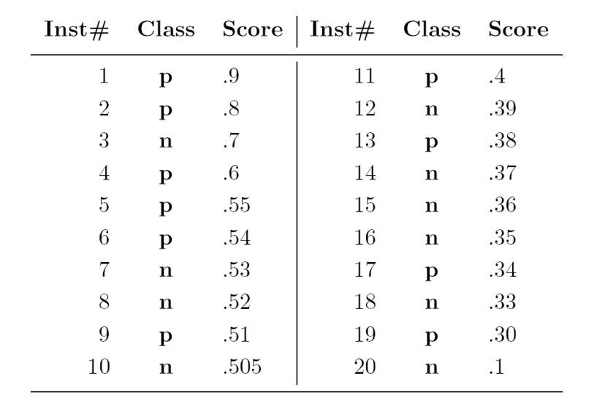
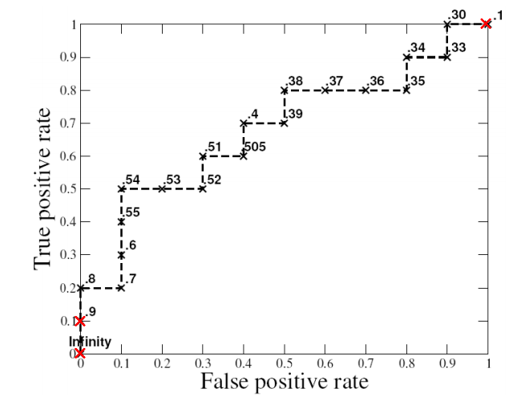
An example
Let’s create the plot!

Slide 32
What AUC really measures…
When AUC is 1…

Slide 33
When AUC is between 0.5 and 1

Slide 34
When AUC is 0.5, and when it’s even lower ……

Slide 35
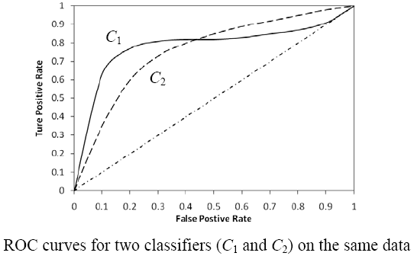
Comparison between models.
Which one is better?

Slide 36
Comparison between models.
Which classifier is better, C₁ or C₂?
It depends on which region you talk about.
Can we have one measure?
Yes, we compute the area under the curve (AUC)
If AUC for C_{i} is greater than that of C_{j}, it is said that C_{i} is better than C_{j}.
If a classifier is perfect, its AUC value is 1
If a classifier makes all random guesses, its AUC value is 0.5.

Slide 37
Cross Validation
What’s the difference between training dataset and test dataset?
How to modify the bias in a one-time classification? …… CV
Examples of a 5-fold classification.
What error does that help fix?
Any other ways?
Let’s put it to extremes …… LOO.

Slide 38
Recap…
What’s data mining? DIKW model?
What’s the TP? FP? TN? FN?
How to calculate recall? Precision? Accuracy? F1 score?
What’s ROC? What’s AUC?
What is cross-validation? LOO?
Why do we need cross-validation?

Slide 39
After class…
Assignment 3.
Reading.
Install R and get ready for next week.

Slide 40
References:
https://towardsdatascience.com/beyond-accuracy-precision-and-recall-3da06bea9f6c
https://towardsdatascience.com/accuracy-precision-recall-or-f1-331fb37c5cb9
https://github.com/yingjun2/IS590dt-19SP

